Slide 2
Interventional radiology (IR)
Interventional radiology (IR) is a sub-specialty of radiology that has become increasingly important since the mid-1970s
Specialises in minimally invasive, image-guided treatments for a wide range of diseases
Gentle alternative to traditional surgical procedures
One of the most dynamic, innovative, rapidly growing areas in medicine
Click here to watch the video!
Find out more at cirse.org

Slide 3
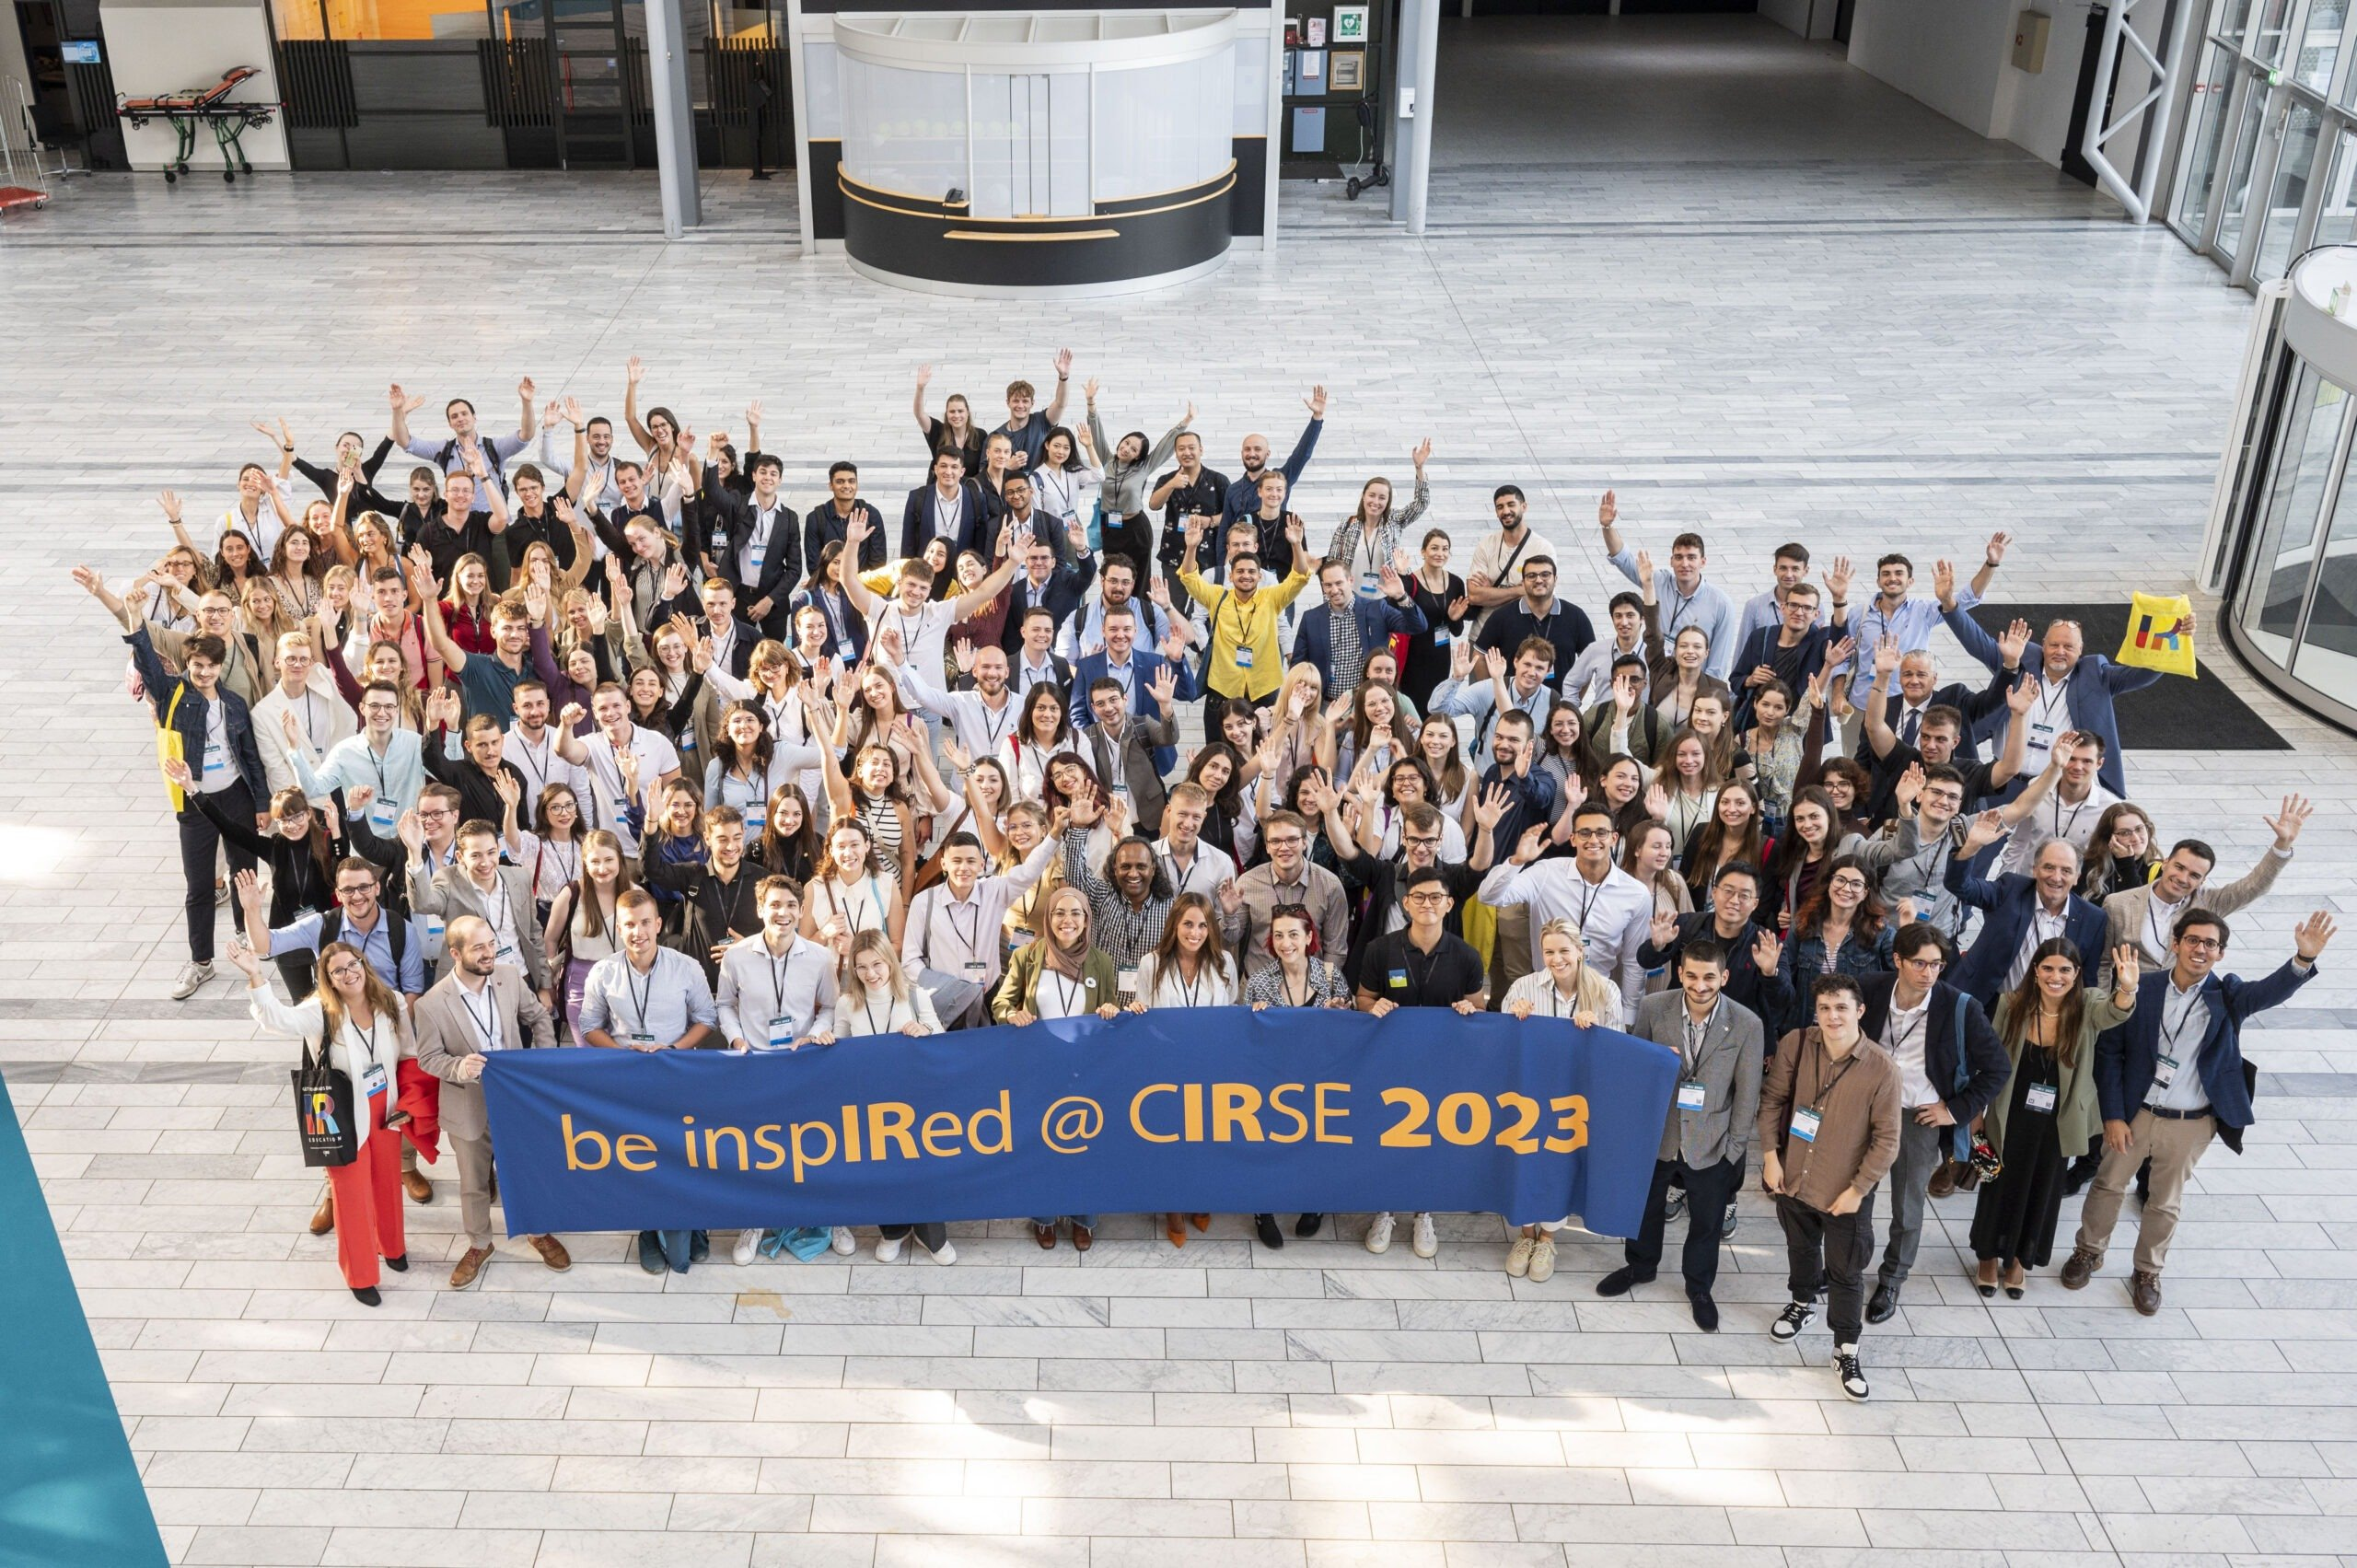
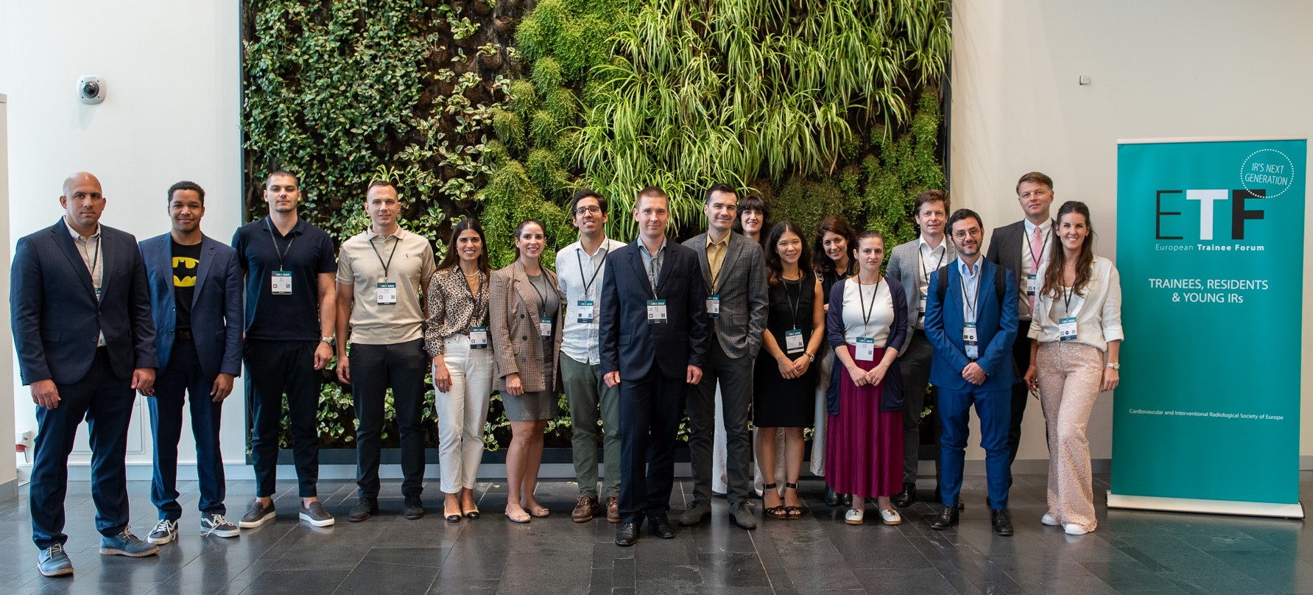
About CIRSE
Cardiovascular and Interventional Radiological Society of Europe (CIRSE) is a non-profit, scientific and educational society founded in 1985
CIRSE has a global network and community of over 44,000 health care professionals, with over 10000 academic members
Our mission is to improve patient care through the support of education, science, research, and clinical practice in the field of IR
And support IR’s next generation…
Medical students
Find out more at cirse.org
IRs in training

Slide 4
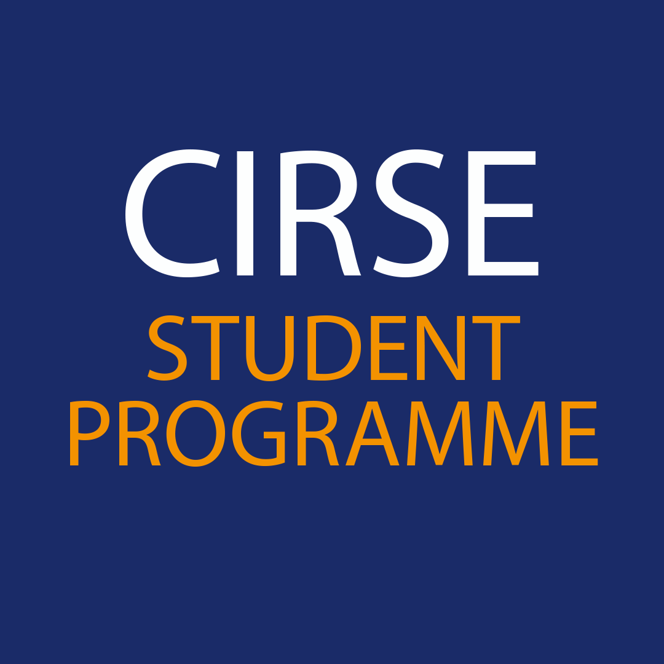
CIRSE Student Programme – What do we offer?
Student Membership
Free congress registration to all CIRSE meetings (CIRSE, ECIO, ET)
Student internships at IR departments in Europe
Webinars on basic IR procedures
Research materials for students (reports, papers and IR curricula)
Educational videos
Networking with junior and senior IRs
Joint activities and events with the CIRSE European Trainee Forum
Find out more at cirse.org/students

Slide 5
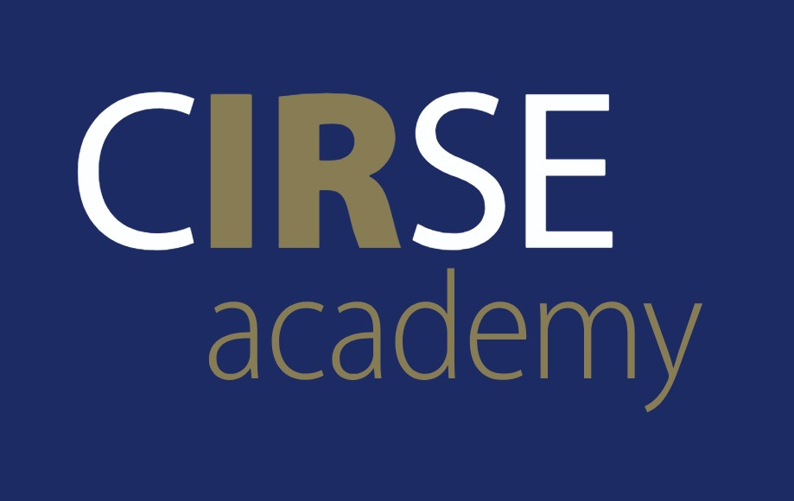
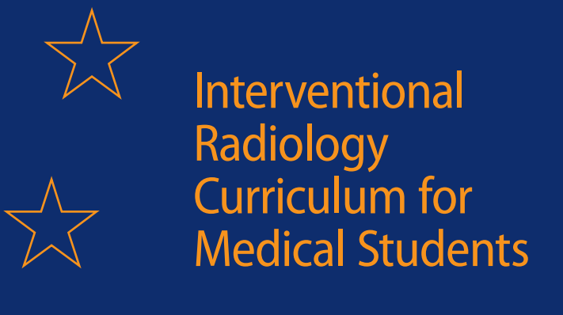
CIRSE student membership – join the CIRSE family!
What are the main benefits?
Free access to CIRSE’s official journal CVIR
Free video streaming via the CIRSE Library
Free CIRSE Academy online courses
Fast track registration for all CIRSE events
Eligibility criteria?
To be enrolled in the first undergraduate degree that started less than 8 years ago
Apply for CIRSE student membership at cirse.org/students/cirse-student-membership/
Find out more at cirse.org/students
@CIRSEstudents

Slide 6
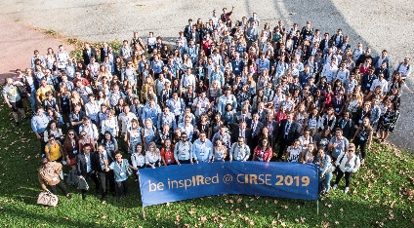
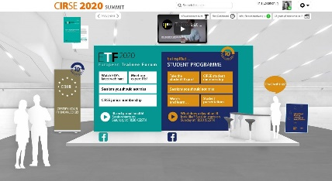
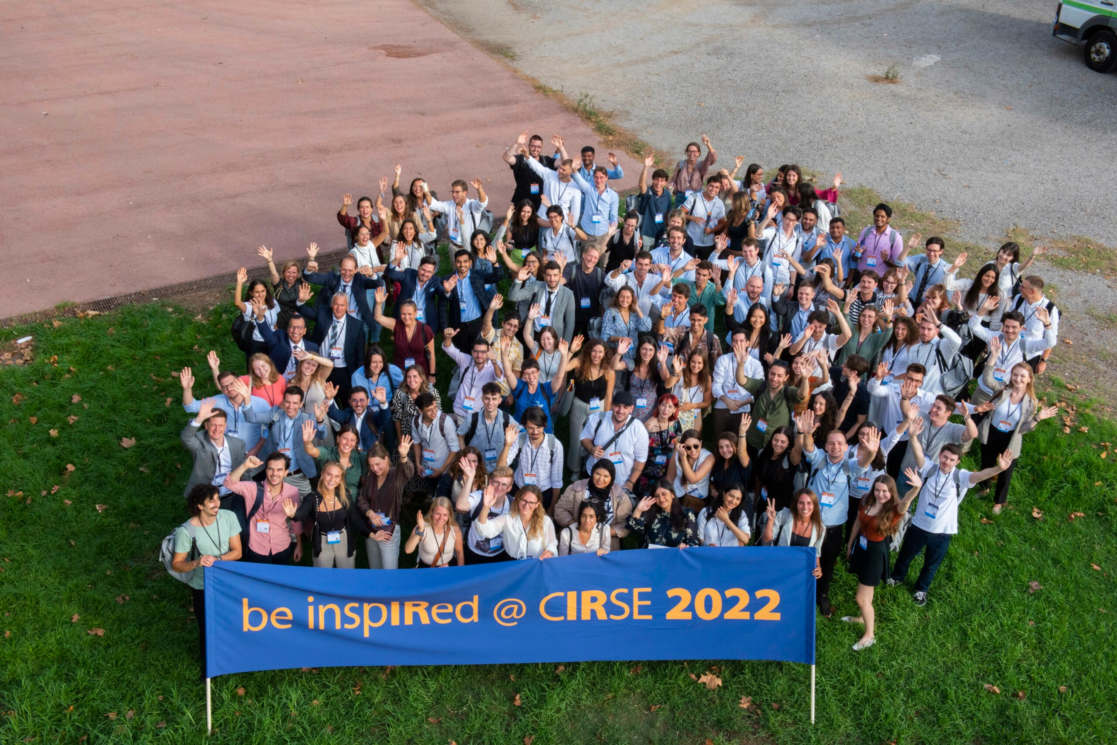
CIRSE Student Programme – be inspIRed…
Provides free congress registration for undergraduate medical students attending CIRSE Annual Meetings
Guides students through their congress experience and provides educational, engaging & fun IR-related sessions and events
Offers activities, events and sessions tailored specifically for medical students
More than 2,800 medical students from all over the world participated in the programme since 2010
CIRSE 2019
CIRSE 2020-2021 online
CIRSE 2022
CIRSE 2023

Slide 7
Why you should be a part of the CIRSE Student Programme?
Deepen your knowledge of IR
Get to know other medical students
Meet leaders in IR
Learn different methods & possibilities of IR practice through Hands-on device training
Get inspired by different IR career paths
Introducing IR Lecture
Recommended scientific sessions & talks
Hands-on device training sessions
Workshops by CIRSE corporate partners
Social events (Mentoring Breakfast, Students’ Evening, Students’ Quiz)
Be inspIRed at #CIRSE2024 (September 14-18) in Lisbon, Portugal. Register now!

Slide 8
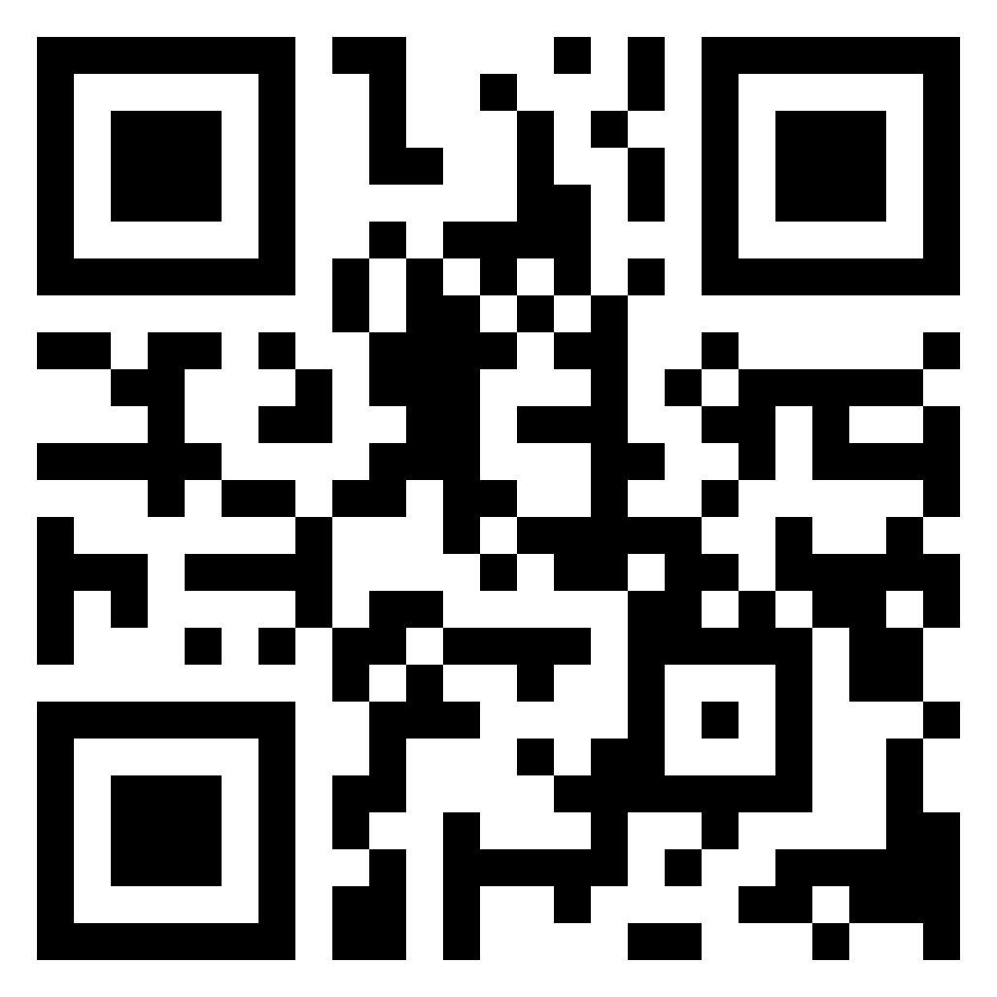
Scan the code
to learn more

