Slide 1
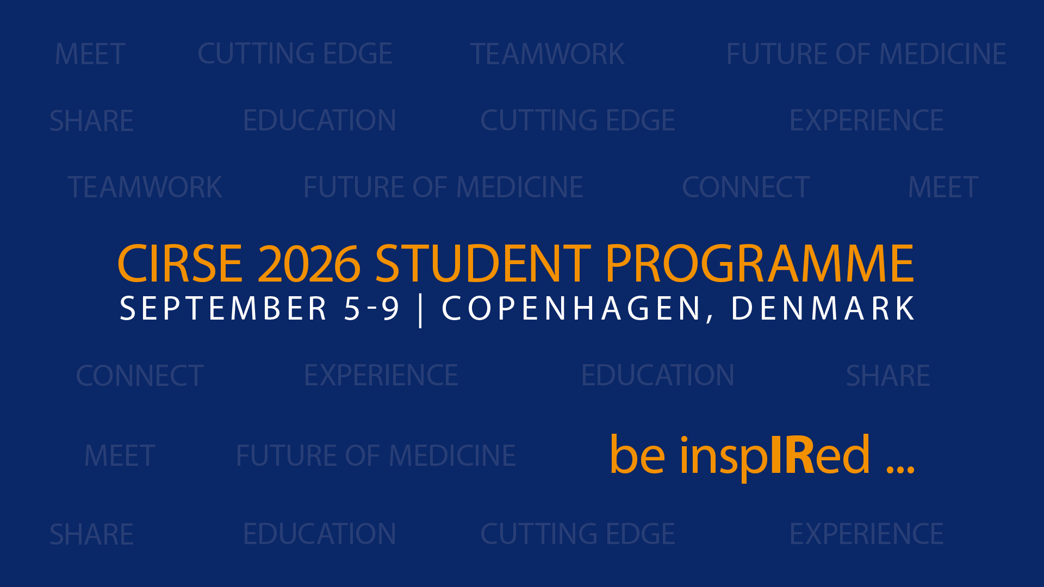

Slide 2



Slide 3
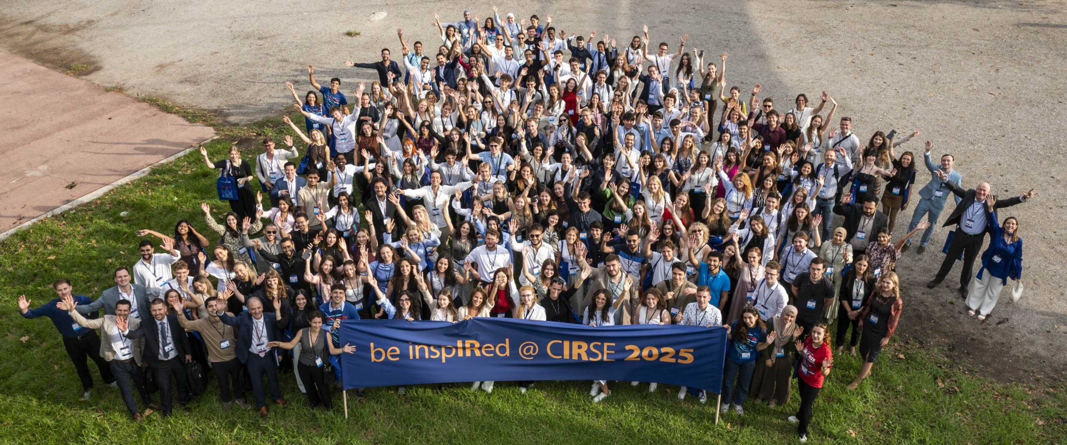
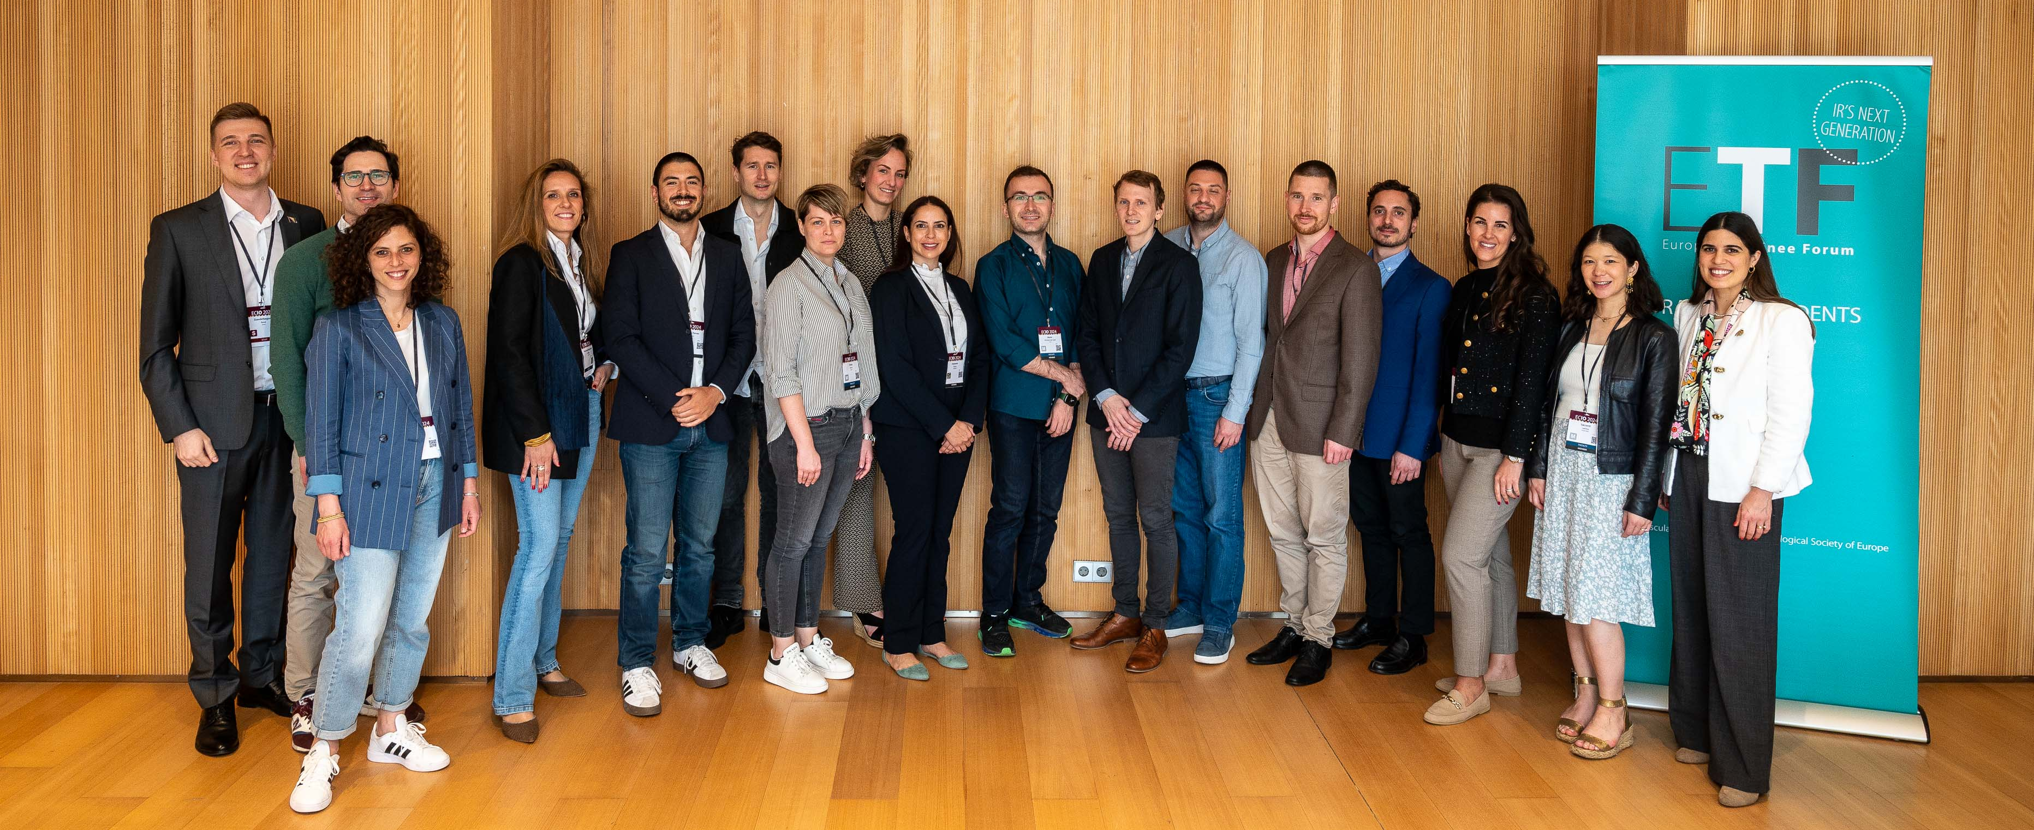
About CIRSE
Cardiovascular and Interventional Radiological Society of Europe (CIRSE) is a non-profit, scientific and educational society founded in 1985
CIRSE has a global network and community with over 10000 academic members
Our mission is to improve patient care through the support of education, science, research, and clinical practice in the field of IR
And support IR’s next generation…
Medical students
Find out more at cirse.org
Residents, trainees and junior IRs

Slide 4
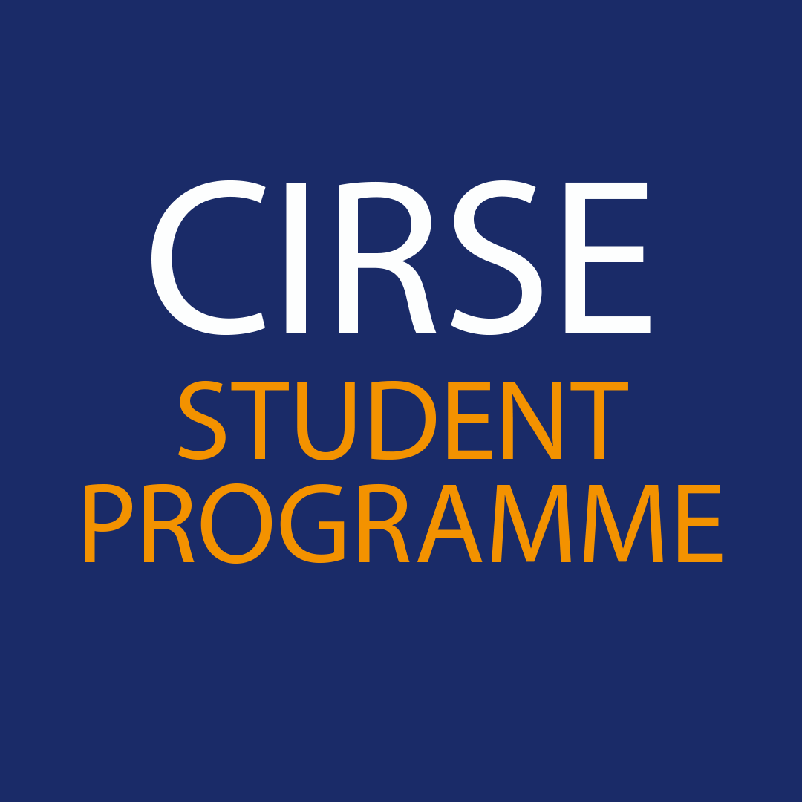
CIRSE Student Programme – What do we offer?
Student Membership
Free congress registration to all CIRSE meetings (CIRSE, ECIO, ET)
Student internships at IR departments in Europe
Webinars on basic IR procedures
Research materials for students (reports, papers and IR curricula)
Educational videos
Networking with junior and senior IRs
Joint activities and events with the CIRSE European Trainee Forum
Find out more at cirse.org/students

Slide 5
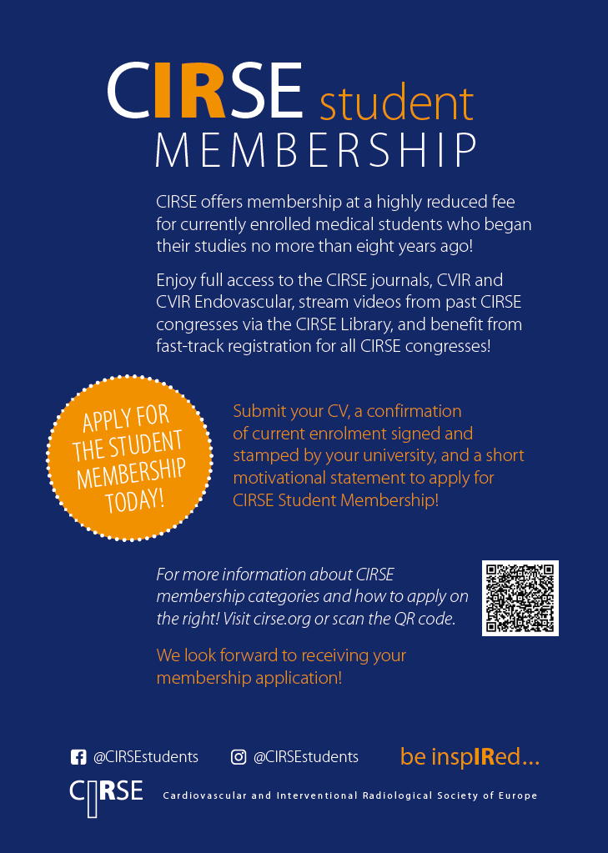
CIRSE student membership – join the CIRSE family!
What are the main benefits?
Free access to CIRSE’s official journals CVIR
Free video streaming via the CIRSE Library
Fast track registration for all CIRSE events
Eligibility criteria?
To be enrolled in the first undergraduate degree
that started less than 8 years ago
Find out more at cirse.org/students

Slide 6
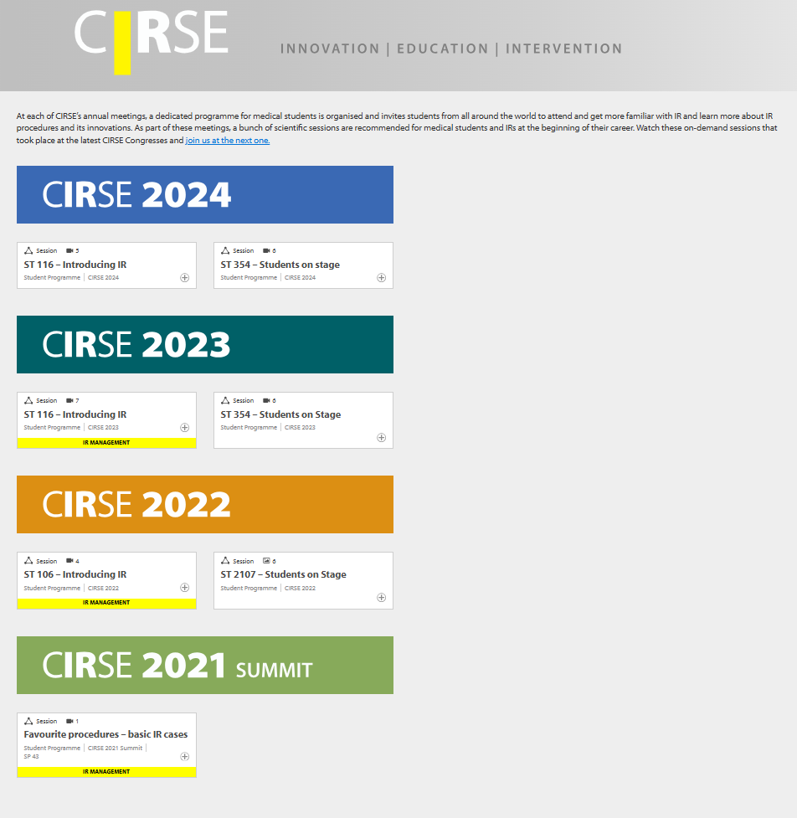
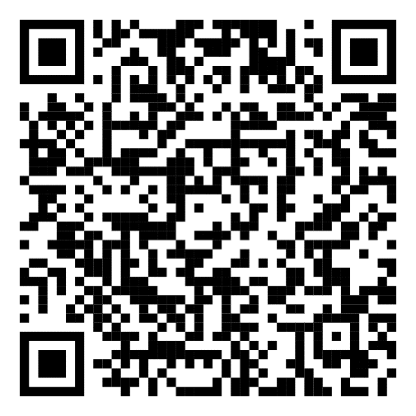

Access the CIRSE Library with your Student Membership!
Your Student Membership allows you to access all content on the CIRSE Library, including all lectures from webinars and CIRSE Congress.
Not sure where to start?
Check out the Student Programme sessions that are targeted at students who want to know more about interventional radiology

Slide 7

Student Programme at CIRSE 2026
Free Congress Registration + Travel Support Grant
Introducing IR session
Recommended scientific sessions & talks
Students’ exclusive HDT and Simulation Trainings
Workshops in cooperation with corporate partners
Students on stage session
Social events: Students’ Meet & Greet, Mentoring event, Students’ evening, Students’ quiz
Students’ section in the CIRSE Event App
This unique congress experience will provide you educational, engaging & fun IR-related sessions and events!

Slide 8
Undergraduate medical students at CIRSE 2026
Travel Support Grant
The first 200 students who successfully register for CIRSE 2026 have a chance to win a CIRSE travel support grant!
Visit cirse.org/students and learn more.
In case you have any questions, please contact us at students@cirse.org.

Slide 9
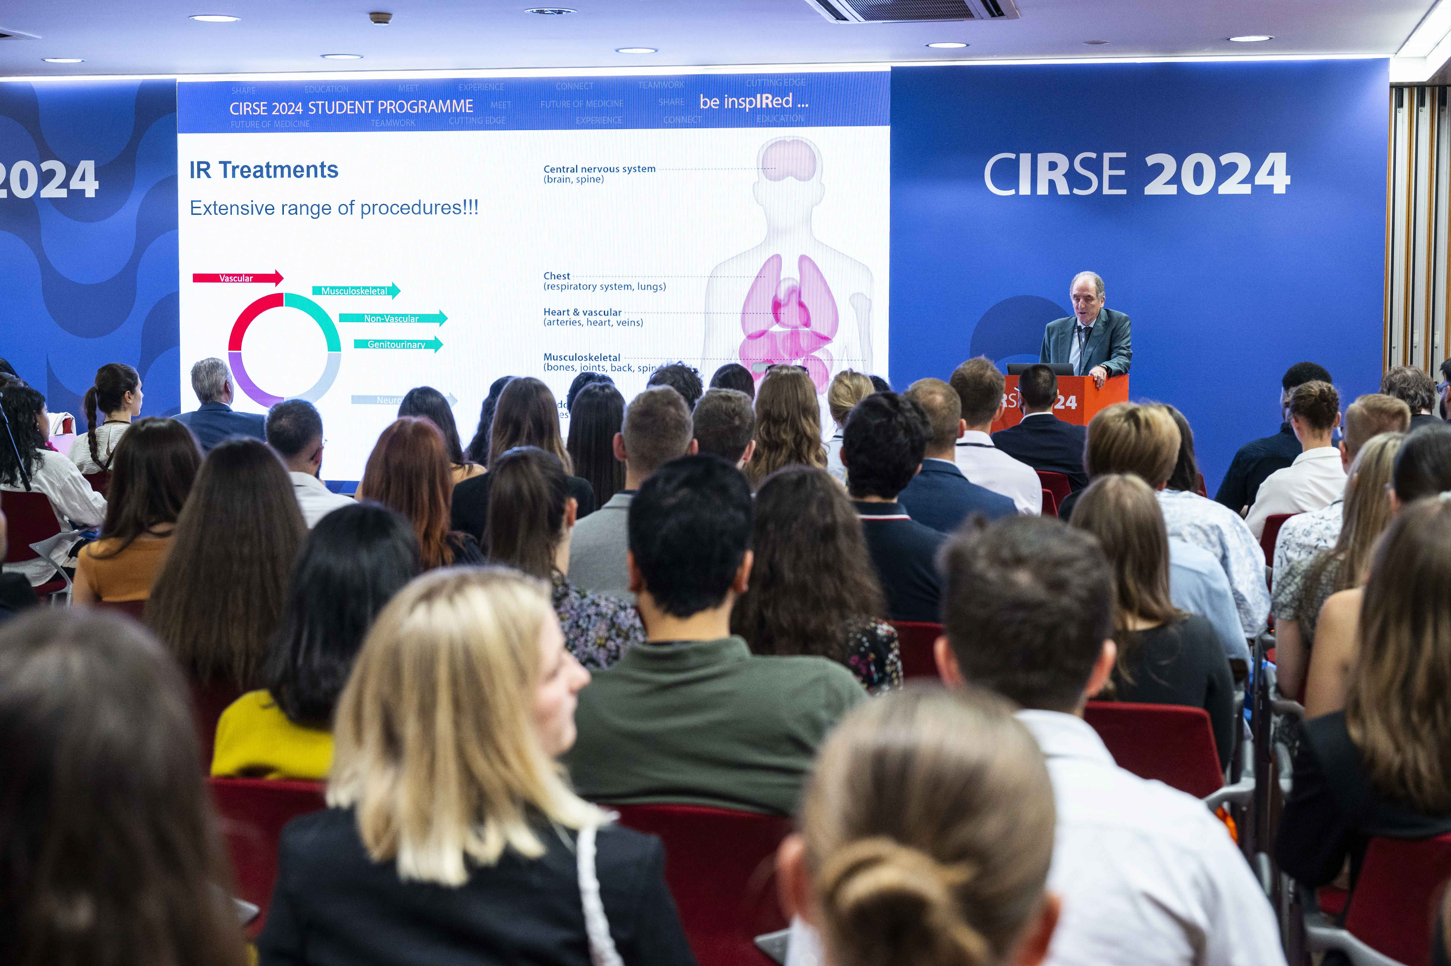
Introducing to IR session
Saturday, 08:30-09:30

Slide 10
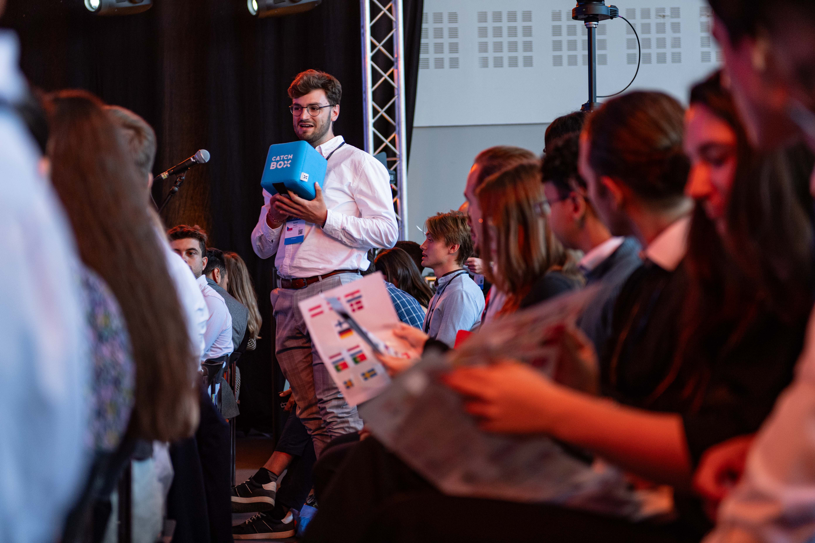
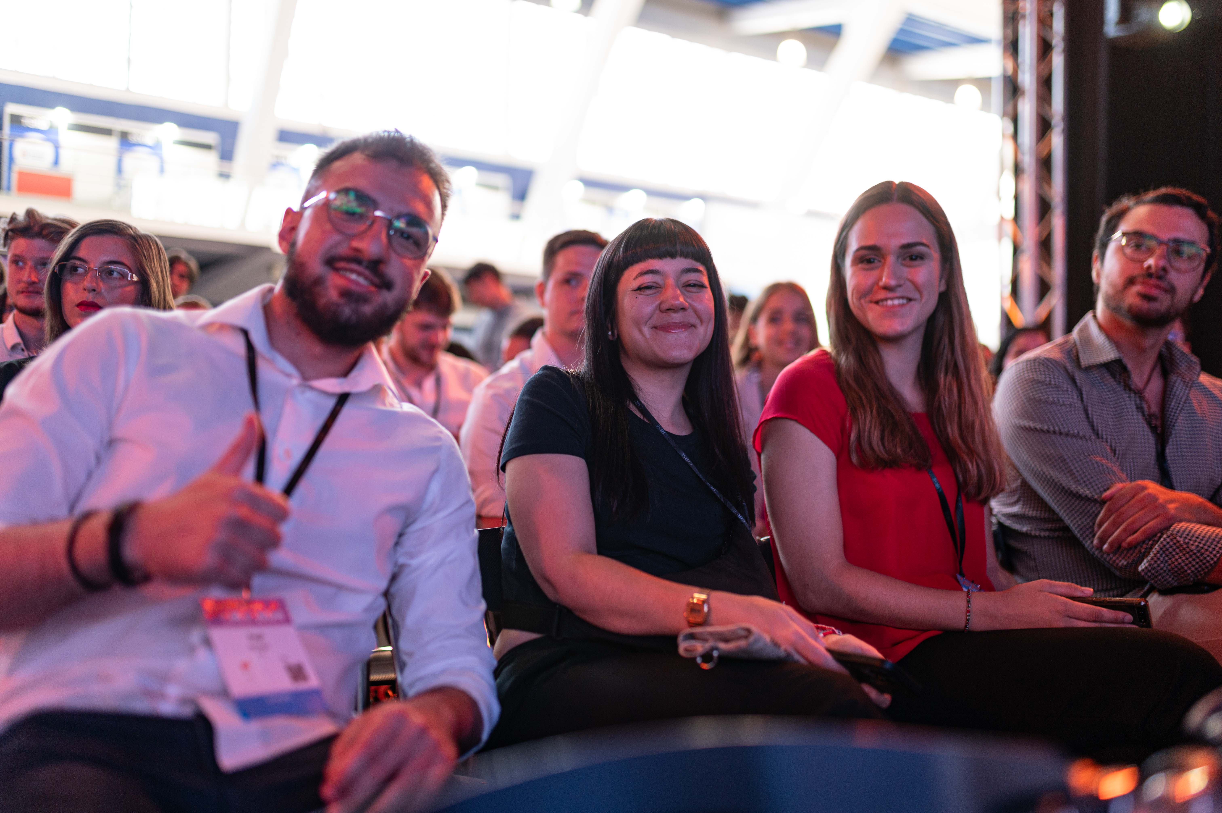
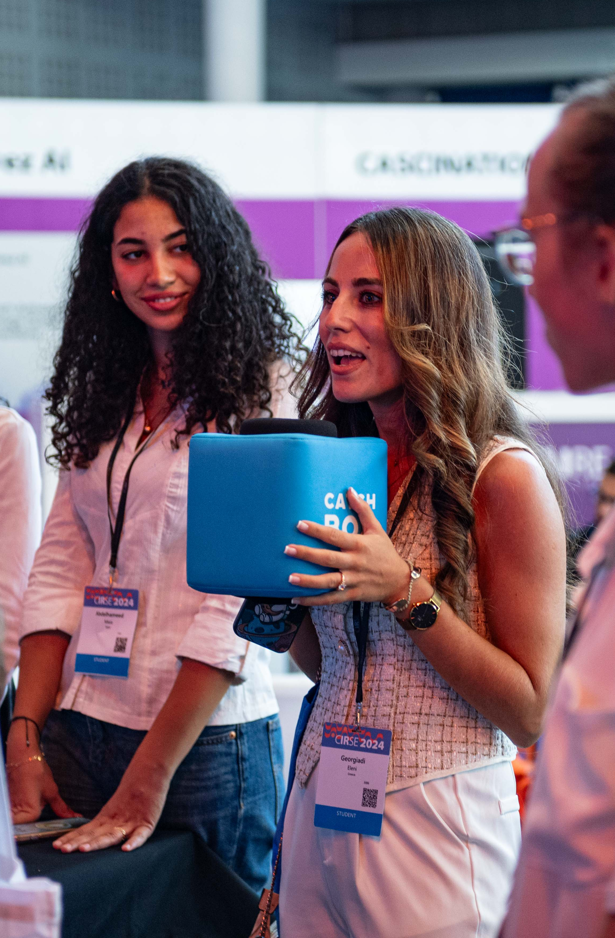
Students’ Meet & Greet
Saturday, 10:00-11:00

Slide 11
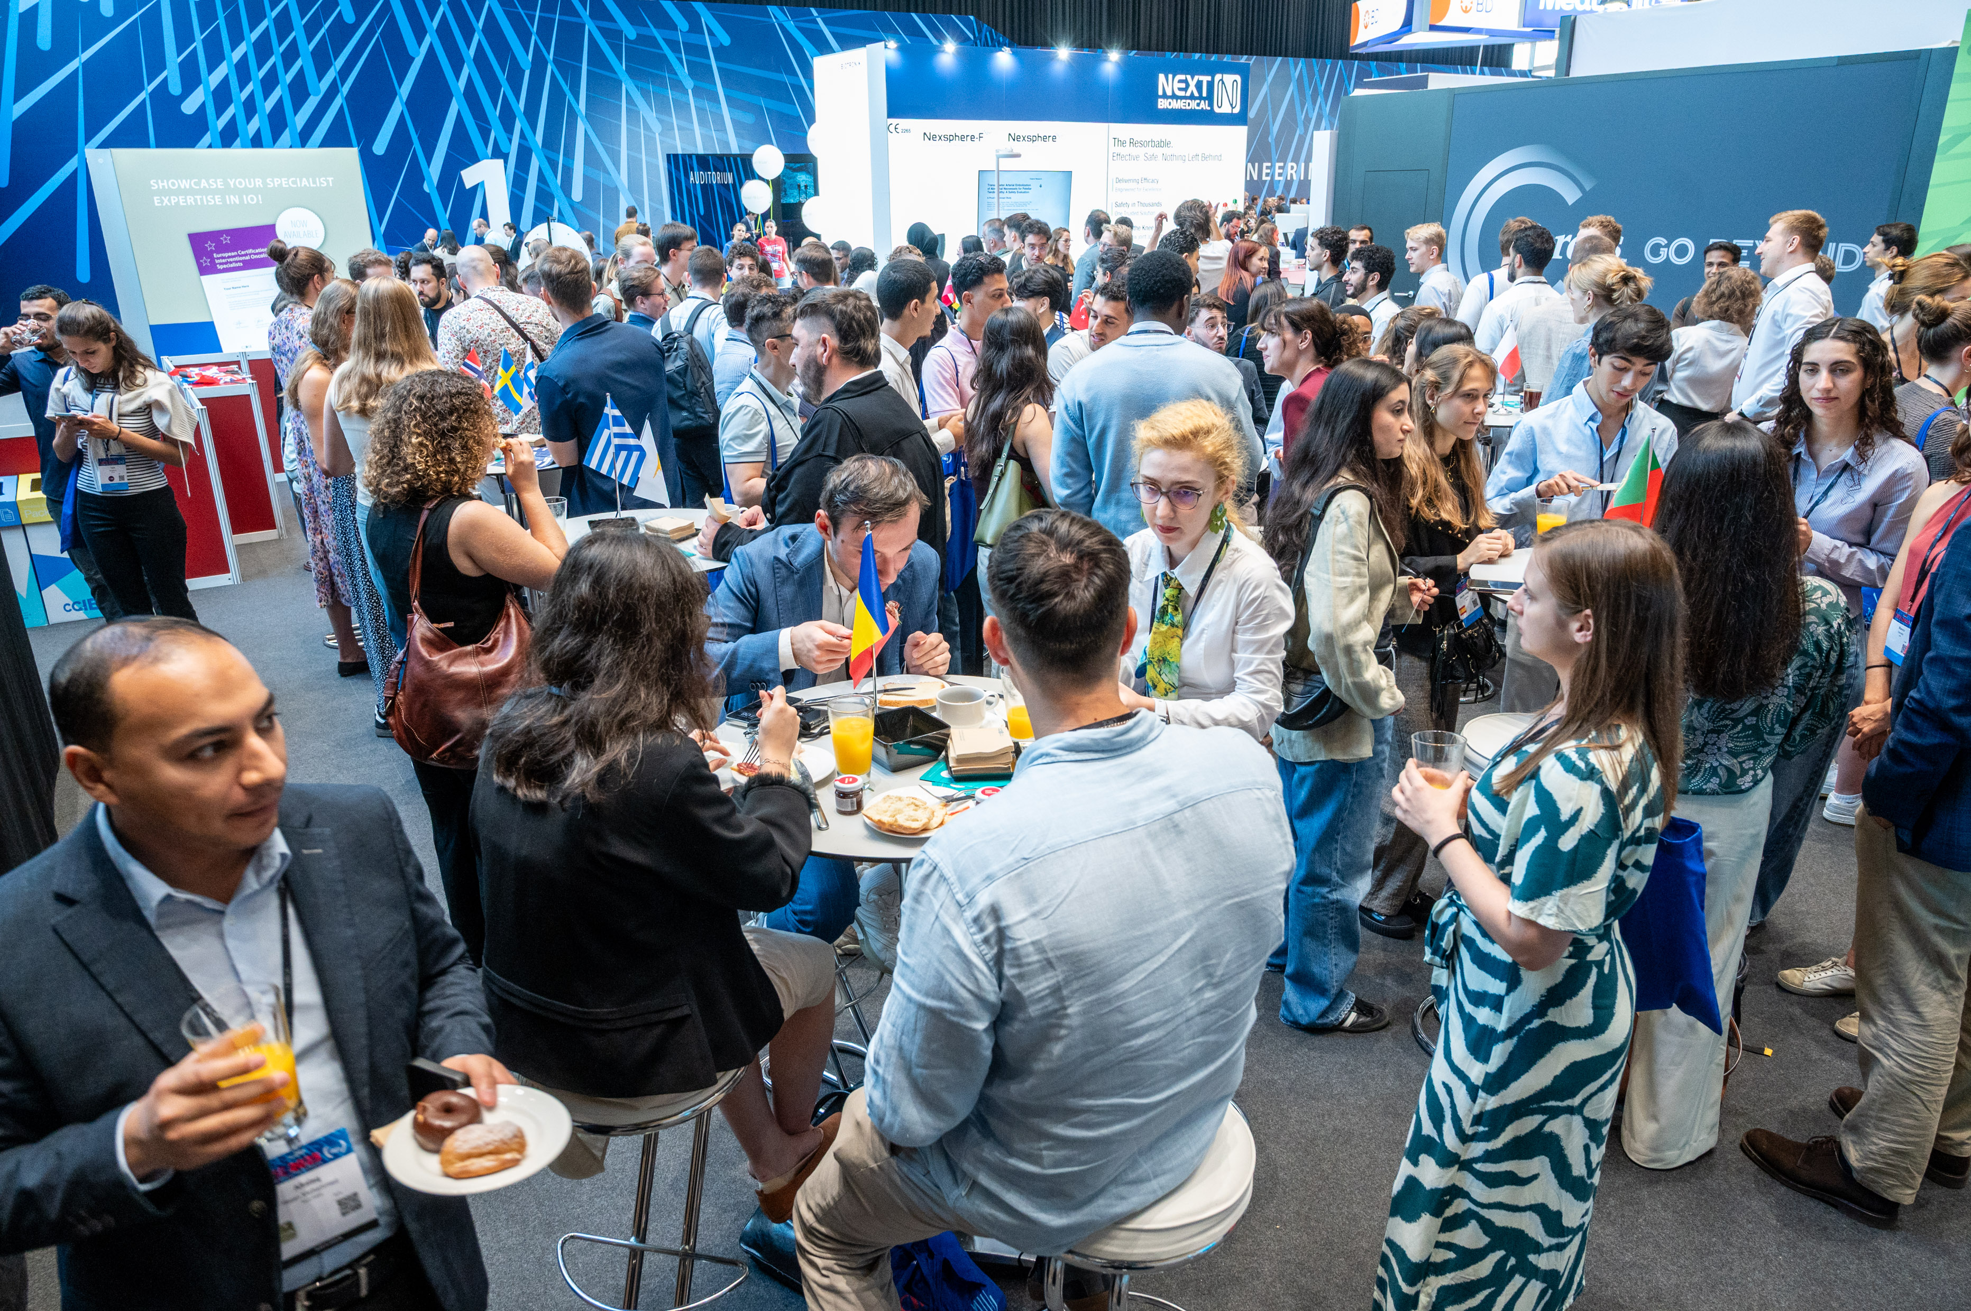
Mentoring event
Sunday, 11:00-12:00

Slide 12

Mentoring event
Sunday, 11:00-12:00

Slide 13
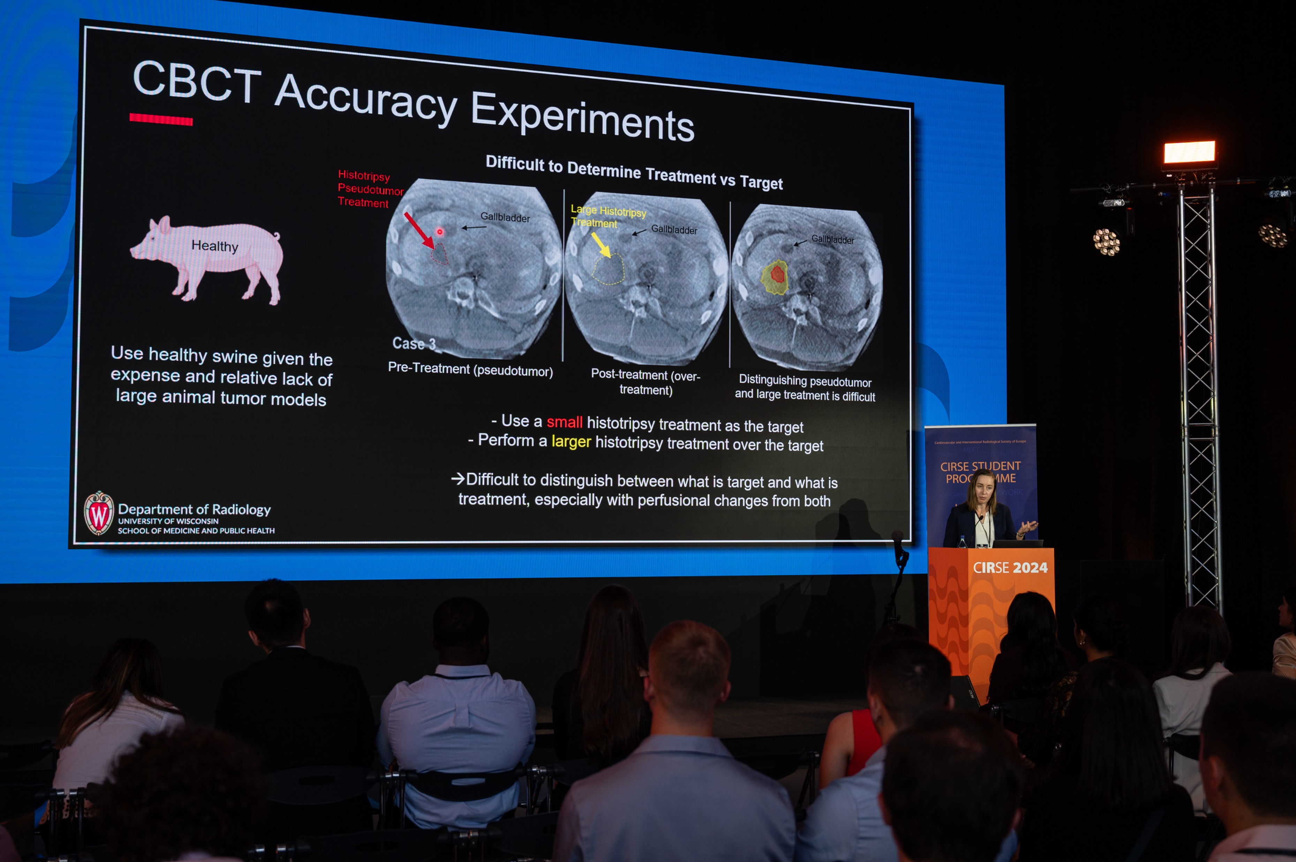
Students on Stage
Monday, 14:00-15:00

Slide 14
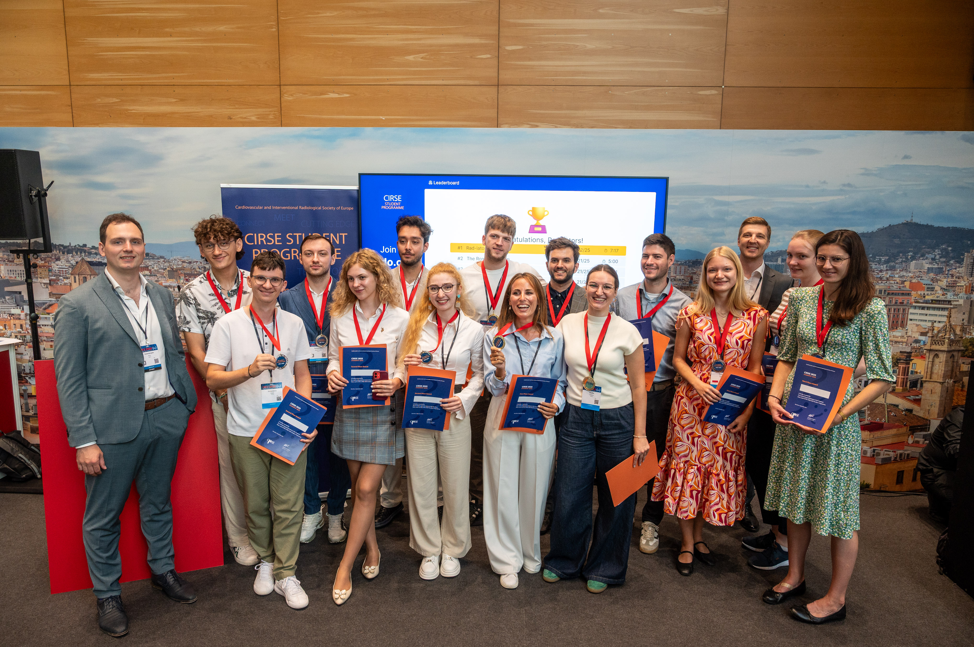
Students’ Quiz
Tuesday, 12:00-13:00

Slide 15
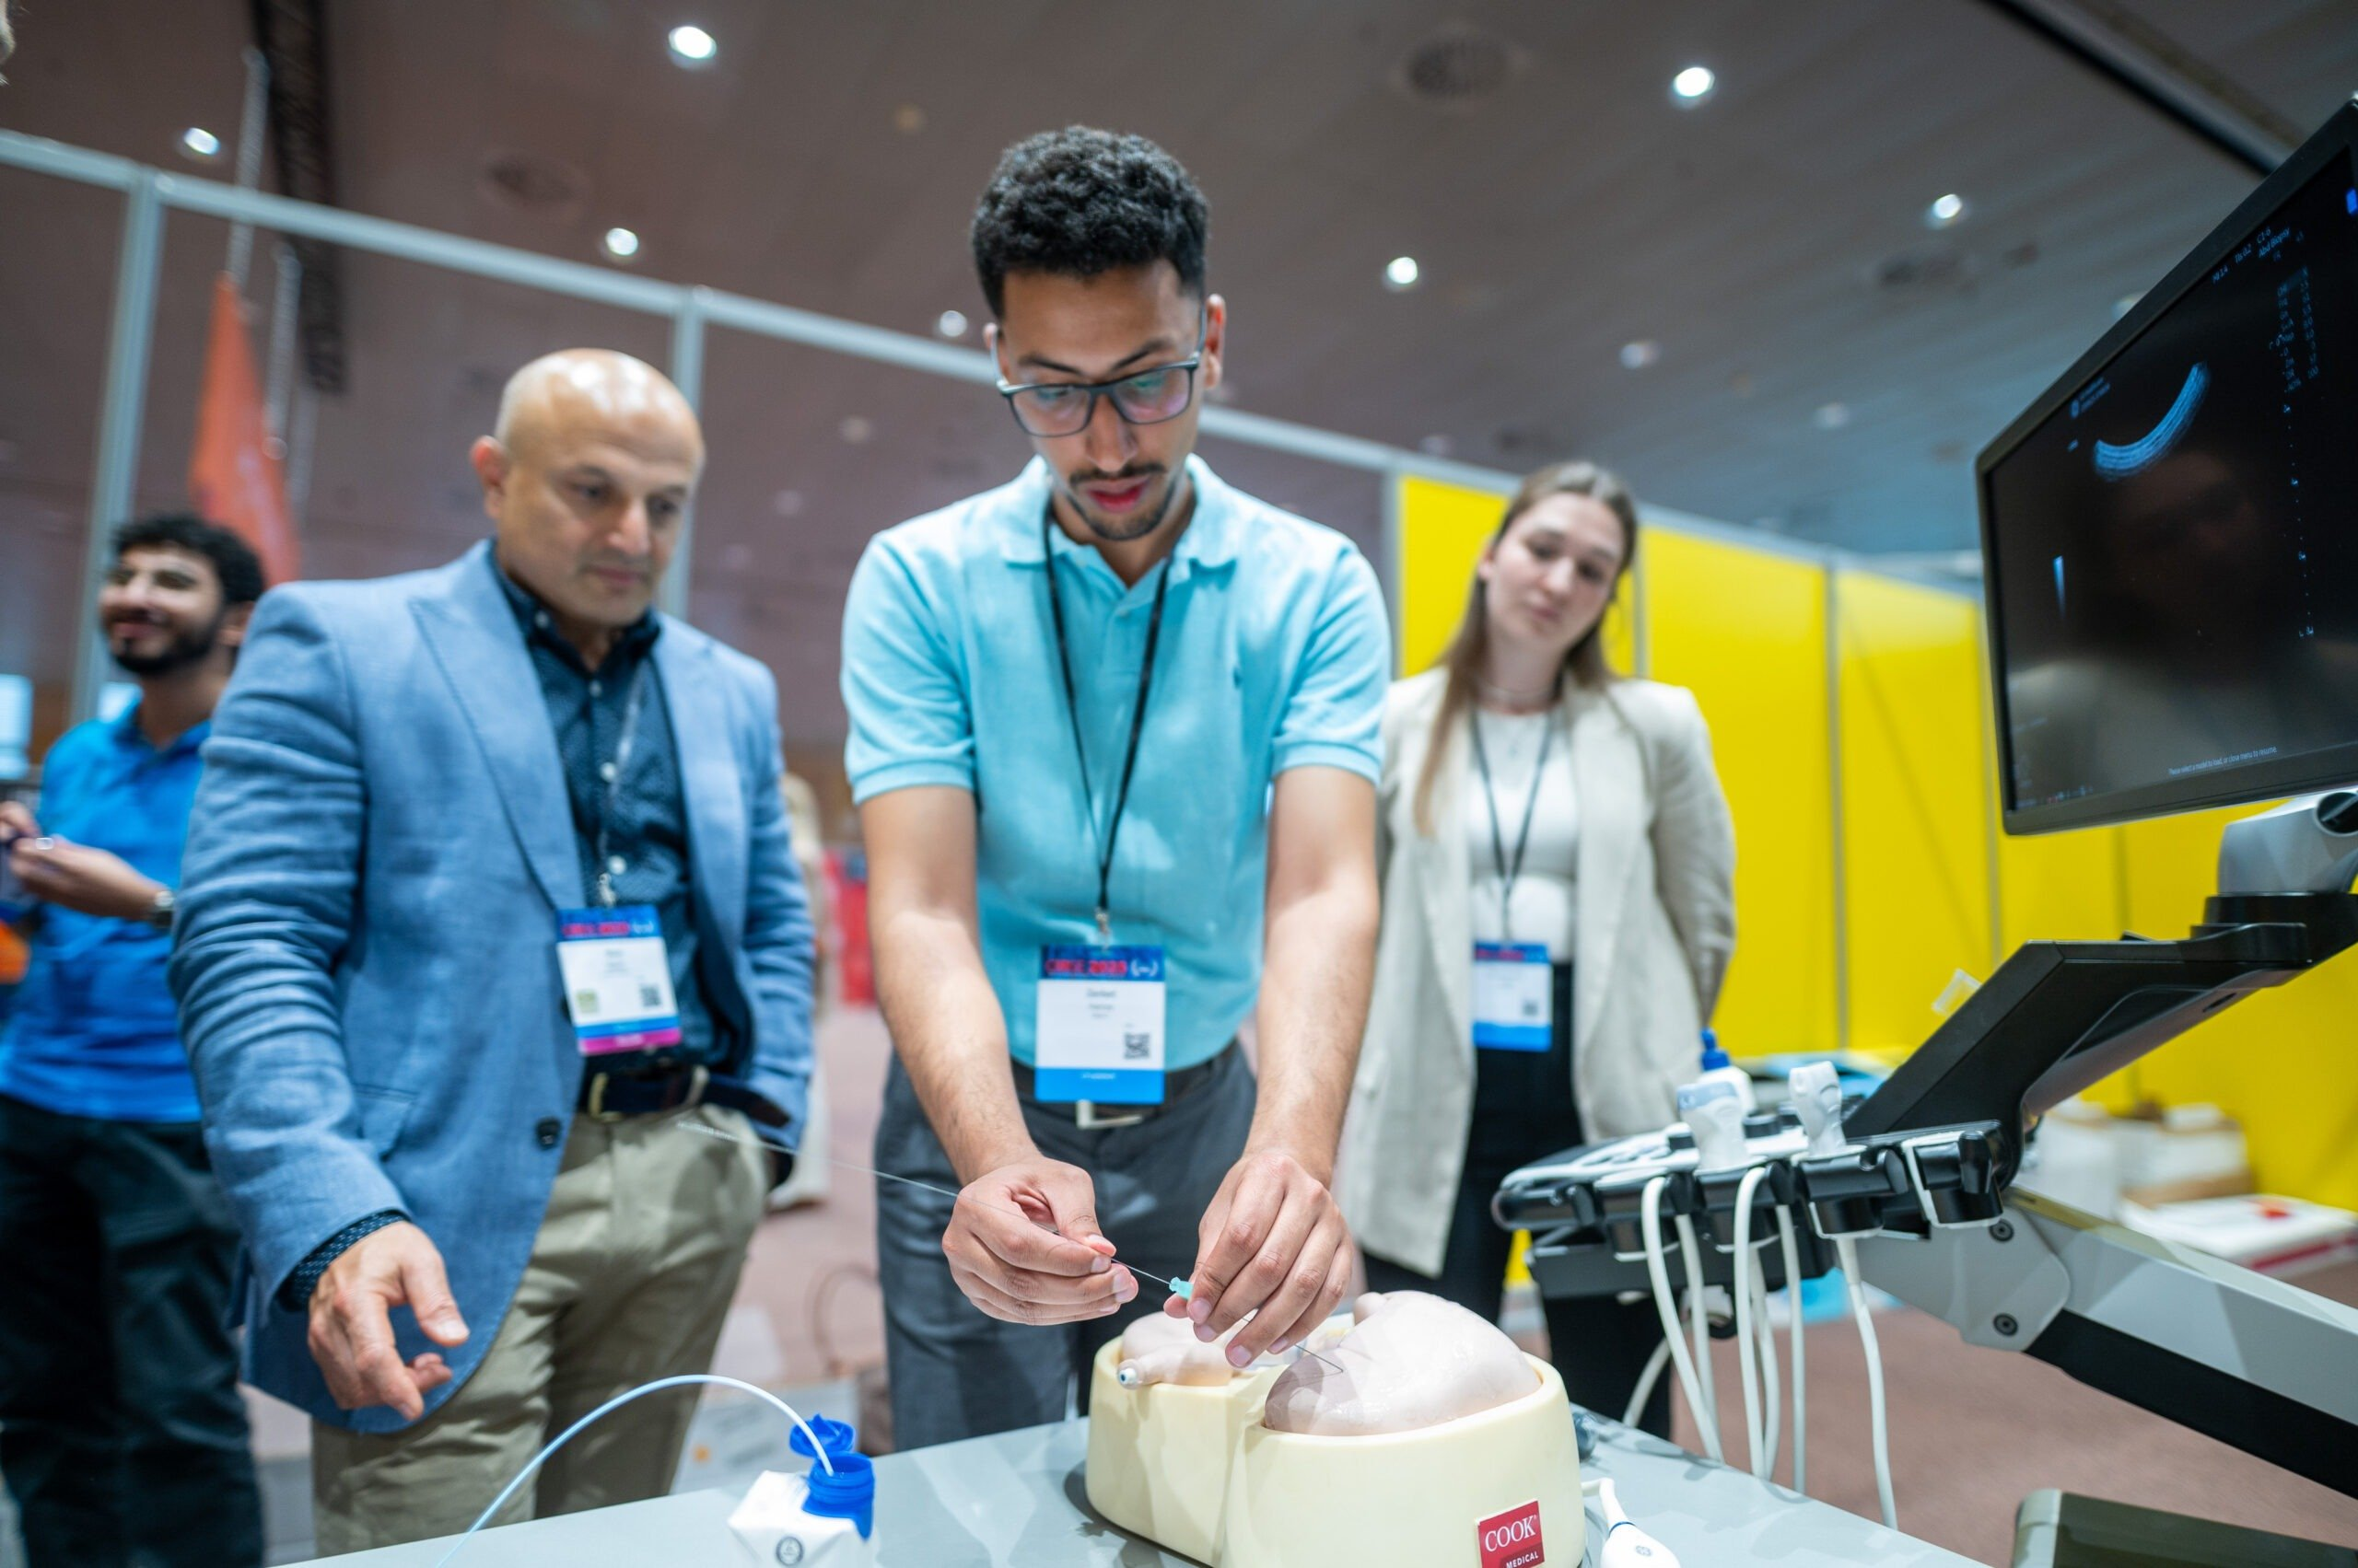
Hands-on device training
Saturday-Tuesday

Slide 16
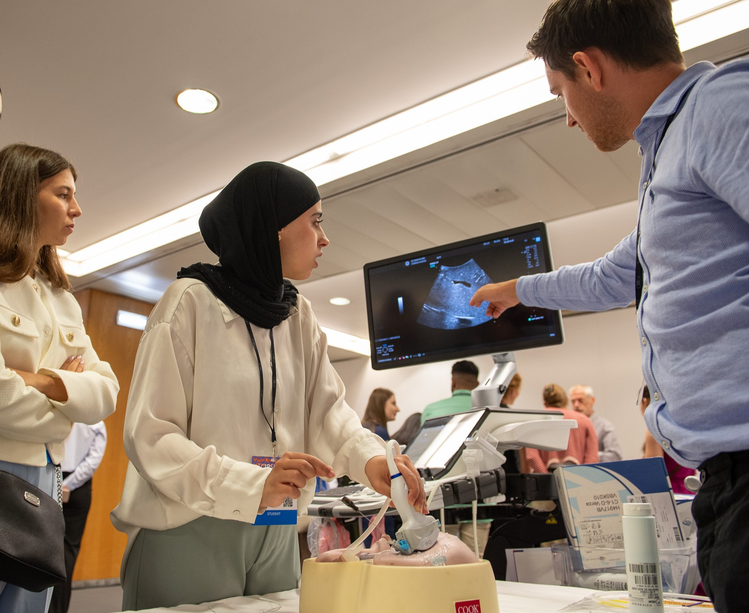
Hands-on device training
Saturday-Tuesday

Slide 17
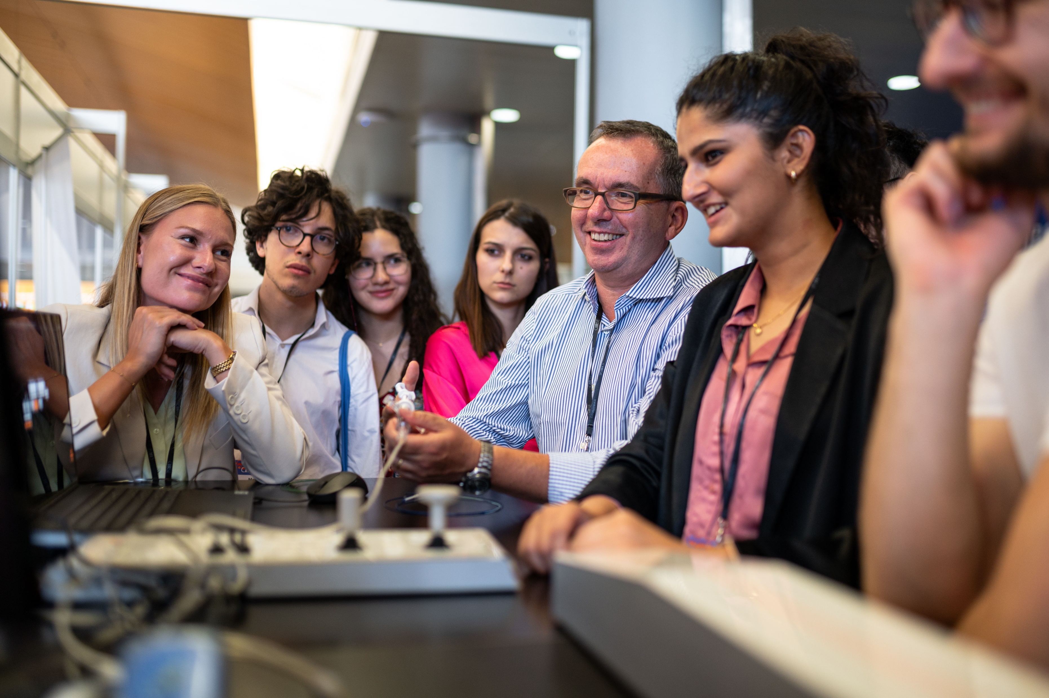
Hands-on device training
Saturday-Tuesday

Slide 18





Why you should be a part of the CIRSE Student Programme?
Deepen your knowledge of IR
Get to know other medical students
Meet leaders in IR
Learn different methods & possibilities of treatments through Hands-on device training
Get inspired by different IR career paths
Introducing IR session
Recommended scientific sessions & talks
Hands-on device training sessions
Workshops by CIRSE corporate partners
Social events
(Mentoring event, Students’ evening, Students’ quiz)

Slide 19
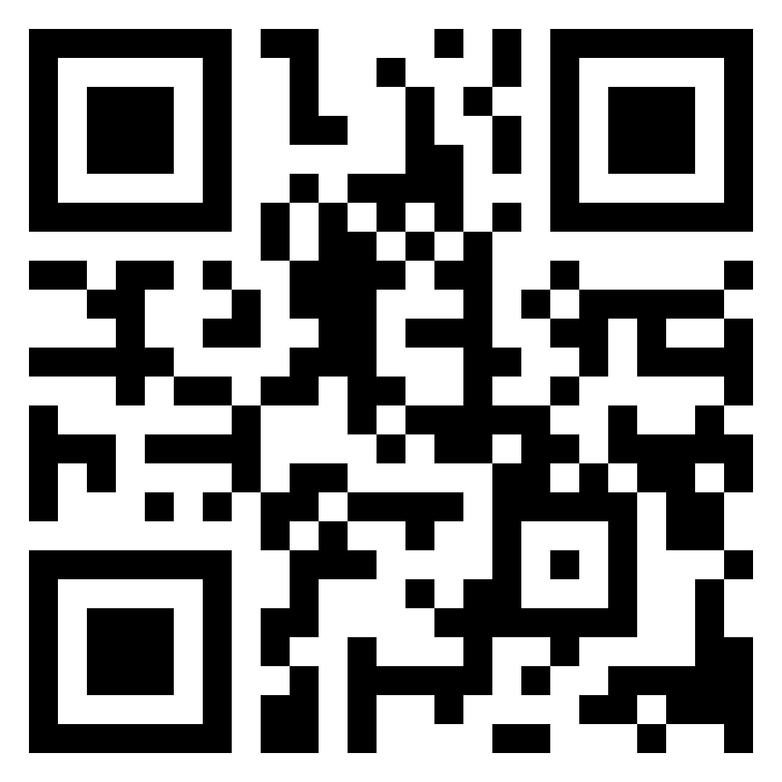
Scan the code
to learn more

Slide 20
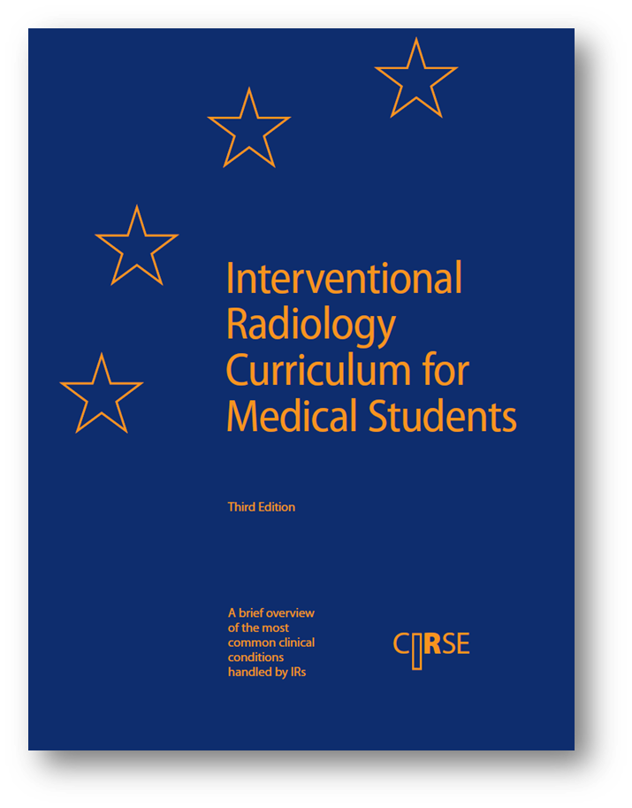
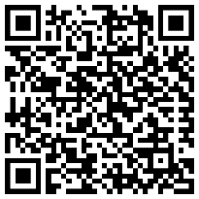
Interventional Radiology Curriculum for Medical Students
This curriculum is designed to make medical students aware of the ever-increasing role of interventional radiology in hospital medicine. It aims to support medical students planning on pursuing a career in IR and those who may participate in a multidisciplinary approach to patient care in the future.
Scan the code to download the curriculum for free at cirse.org

Slide 21


